Slide 1


Data Wrangling ASG2
Law Jun Jie (S10243668)

Slide 2
Content
Problem Understanding
01
Data Wangling on Multiple Tables
02
Data Cleansing and Transformation
03
Machine Learning Model
04

Slide 3
Problem Understanding

Slide 4
Problem Understanding
Aim:
Predicting the Top 3 Drivers who will win the race
Tables Used:
Results_mod
Races_mod
Driver_mod
Driver_standings_mod
Circuits_mod

Slide 5
Data Wangling on Multiple Tables

Slide 6
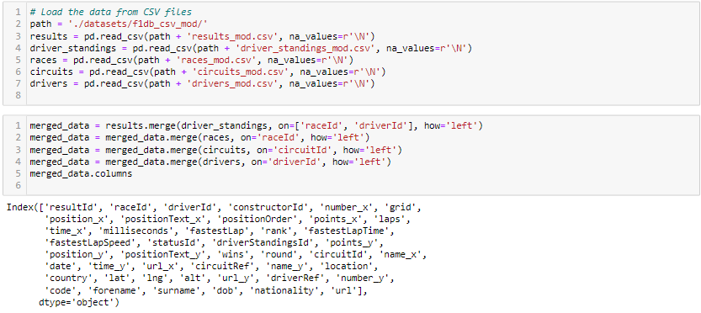
Data Wangling on Multiple Tables
Loading the Data

Slide 7
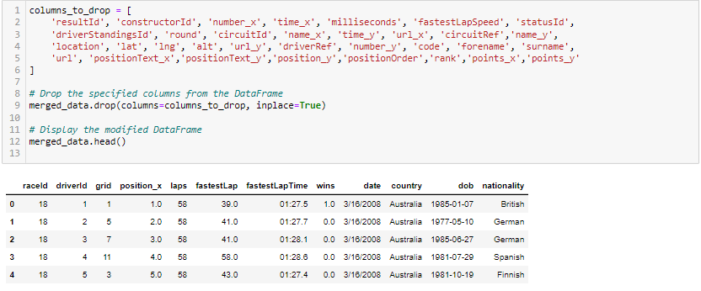
Data Wangling on Multiple Tables
Drop Unnecessary Column

Slide 8
After dropping the respective columns
Position
Points
Accuracy: 0.9690288713910761
Precision: 0.9539295392953929
Recall: 0.7770419426048565
F1-Score: 0.856447688564477
Accuracy: 0.8858267716535433
Precision: 0.7093023255813954
Recall: 0.0673289183222958
F1-Score: 0.12298387096774194
Notes:
Columns with these 2 words, result in an overfit

Slide 9
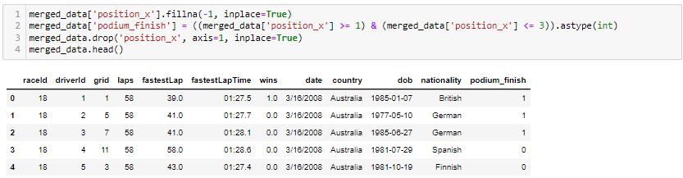
Data Wangling on Multiple Tables
Create Target Column

Slide 10
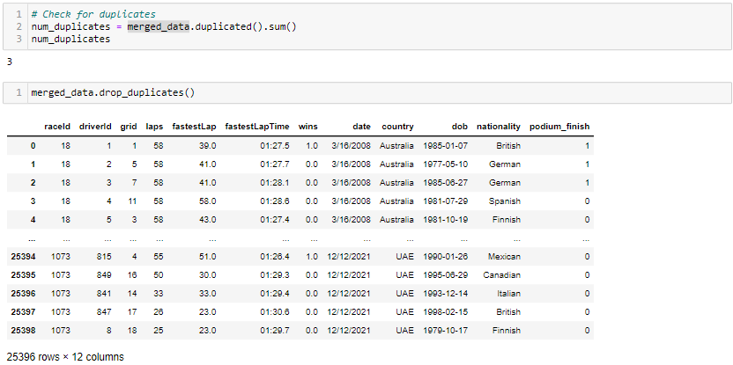
Data Cleansing and Transformation
Removing Duplicates

Slide 11
Data Cleansing and Transformation
Missing Data Imputation

Slide 12
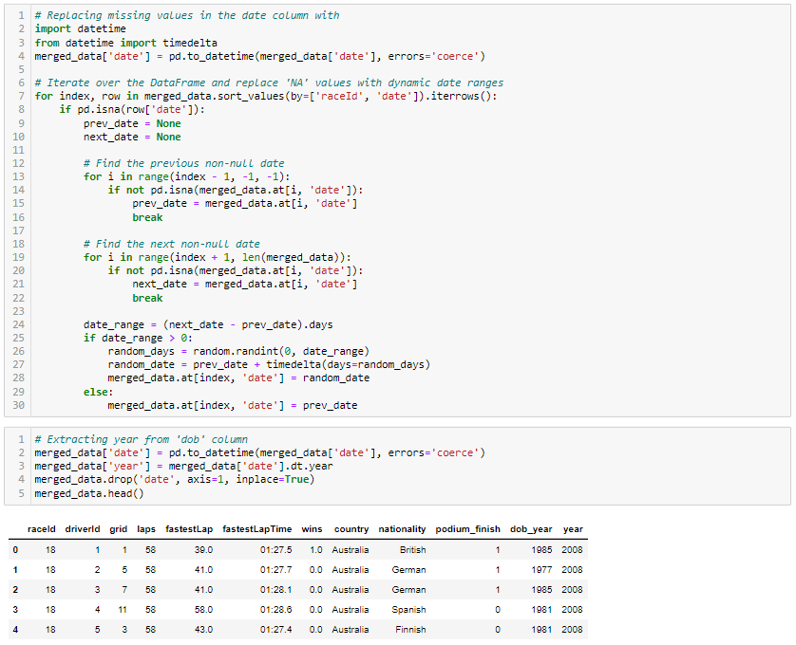
Data Cleansing and Transformation
Replacing Missing Values for date column
Extracting the Year out from the date column
Notes:
Since the dates is sorted according to the raceID, I can impute missing dates based on raceID.
Extracting the year from a date can help capture the seasonal patterns or yearly trends in your data.

Slide 13
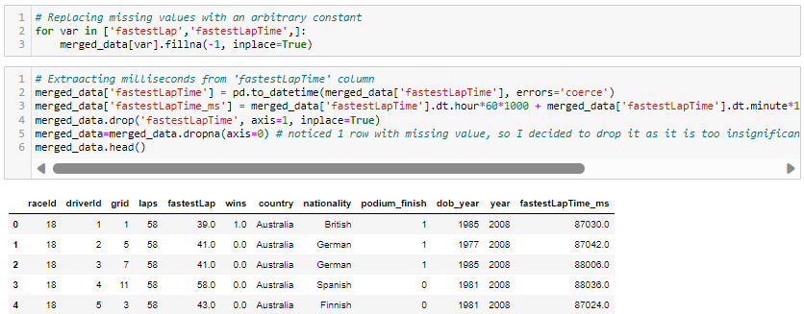
Data Cleansing and Transformation
Replacing Missing Values for fastestLap & fastestLapTime column
Extracting the milliseconds from the fastestLapTime column
Notes:
Since these column represents the fastest lap and fastest lap time of the driver in a race, it is reasonable to assume that a missing value might indicate that the driver did not set a fastest lap or the information is missing, I can use an arbitrary value like -1 to differentiate between drivers who did not set a fastest lap and fastest lap time. By extracting specific components from dates or times, you're creating new features that might have stronger correlations with your target variable. This can enhance the model's ability to capture complex relationships.

Slide 14
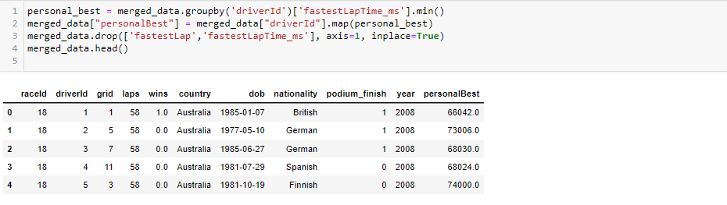
Data Cleansing and Transformation
Extracting the personalBest from the fastestLapTime_ms column
Drop fastestLap & fastestLapTime_ms column
Notes:
After careful considerations, I realised that fastestLap and fastestLapTime_ms are variables that I will not know before the race, therefore i decided to come up with a variable personalBest and drop the 2 columns.

Slide 15
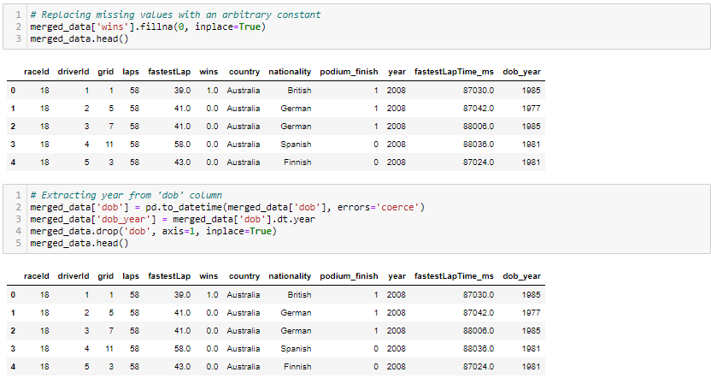
Data Cleansing and Transformation
Replacing Missing Values for wins column
Extracting the year from the dob column
Notes:
Wins column seem to be related to driver standings and performance metrics. It is reasonable to assume that a missing value might indicate that the driver did not win, you can replace the missing values with 0 as it distinguishes missing values from actual winnings.
By extracting specific components from dates or times, you're creating new features that might have stronger correlations with your target variable. This can enhance the model's ability to capture complex relationships.

Slide 16
Data Cleansing and Transformation
Dealing with Outliers

Slide 17
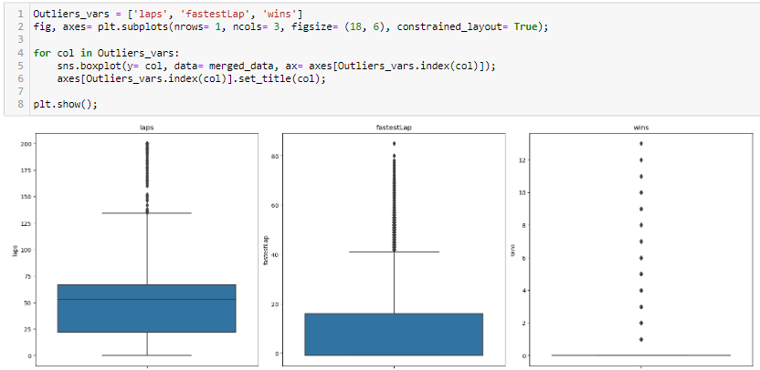
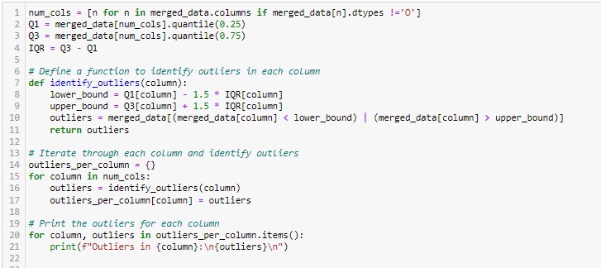
Data Cleansing and Transformation
Identify columns with outliers
Columns with outliers:
podium_finish
driverID
wins
laps
Notes:
podium_finish:
Since this is a binary variable (0 or 1) and it is the Y value, it is not be necessary to handle outliers.
driverID:
Since this is an identifier it is not relevant to apply outlier-handling techniques.
wins:
Since only 1 driver will win for each race, most drivers will not have any wins. Therefore, the data would be right skewed, with most of the values being 0. Thus, zero-capping and windsoriztion would be unsuitable for this feature. Hence, I could apply outlier trimming or capping to limit their impact.
fastestLap, laps:
Similar to wins, I can apply outlier trimming or capping as both extremely fast and extremely slow lap times are outliers.

Slide 18
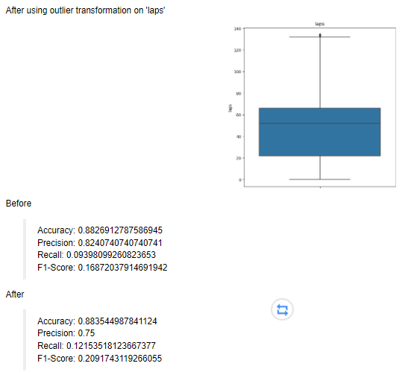
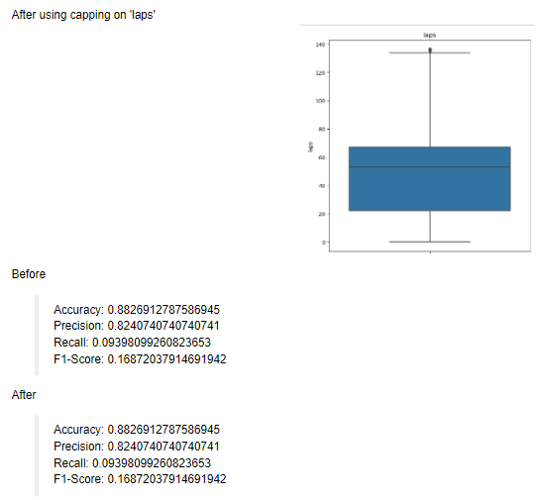
Data Cleansing and Transformation

Slide 19
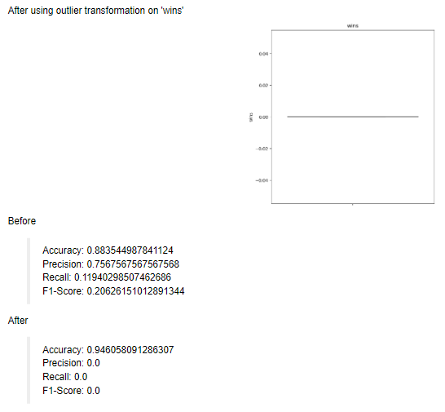
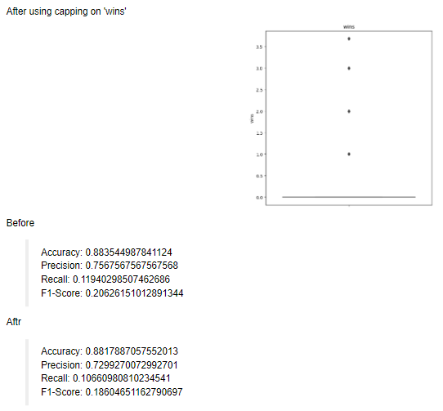
Data Cleansing and Transformation

Slide 20
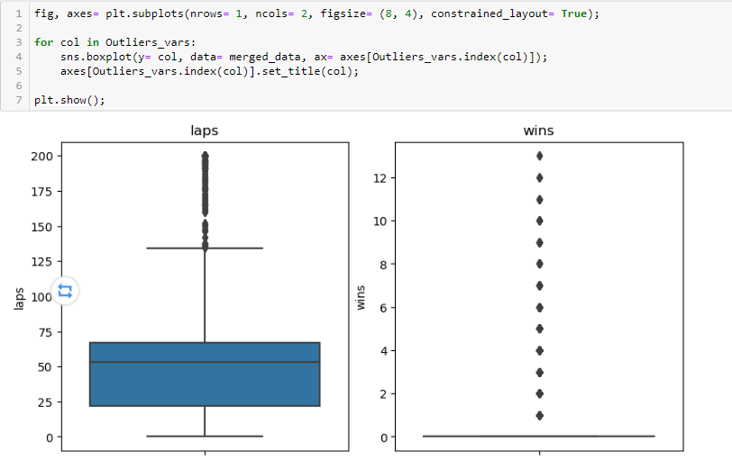
Data Cleansing and Transformation
Notes:
wins:
Testing across all outlier handling methods proved ineffective and made a negative impact to the distribution. Therefore, it is not transformed to preserve its original value which in itself may prove more valuable for analysis.
laps:
Testing across all outlier handling methods proved ineffective and made a negative impact to the distribution. Therefore, it is not transformed to preserve its original value which in itself may prove more valuable for analysis.

Slide 21
Data Cleansing and Transformation
Numerical Transformation

Slide 22
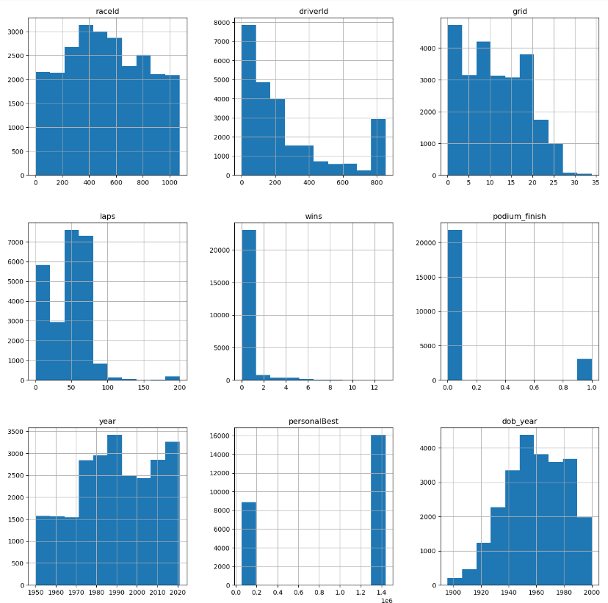
Notes:
'podium_finish': No Transformation
> Since 'podium_finish' is a binary variable (0 or 1), it's already in a suitable format for modeling. No transformation is needed.
'raceId', 'driverId': No Transformation
> These are categorical identifiers, and transformations are not applicable.
'grid', 'laps', 'wins'
> Since these variables contain values that are 0, Logarithmic and Box-Cox transformation are not suitable. Square-root trasformation seems visible as it can help moderate effect on distribution. Furthermore, square-root transformation can be applied to zero values.
'dob_year', 'year': Reciprocal Transformation
> Both variables are not skewed and the values are all positive. Therefore, a Reciprocal transformation is the most suitable. It can help to reduce the effect of extreme values and make the distribution more normal. 'personalBest'
The variable is high skewed and has a non-normal distribution. Therefore a Log transformation is suitable as the skewness is reduced .

Slide 23
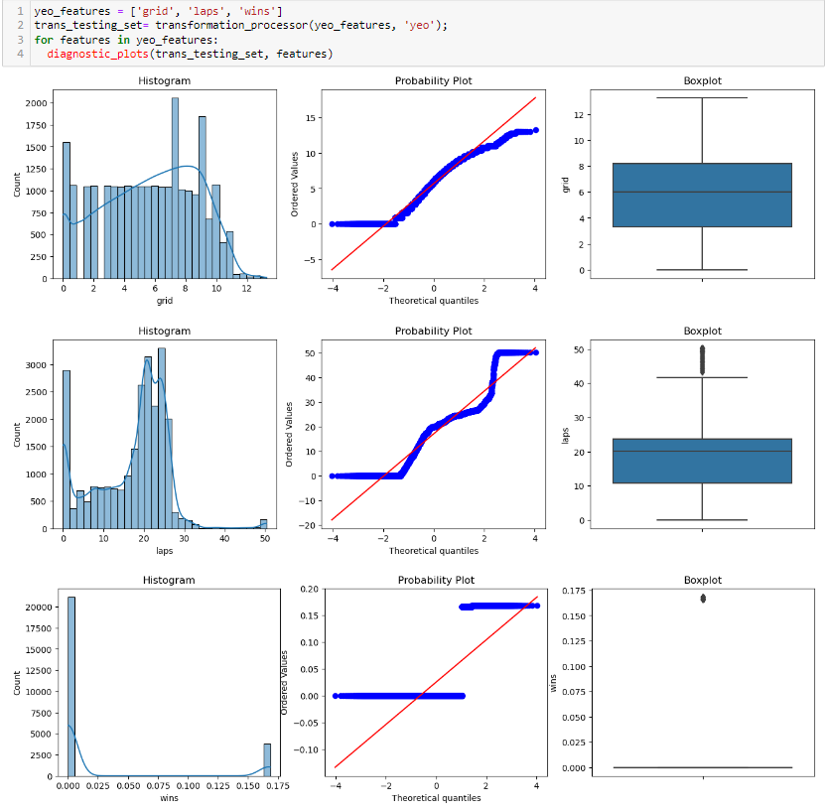
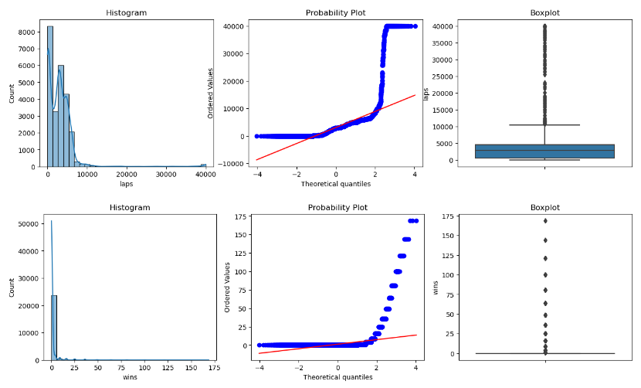
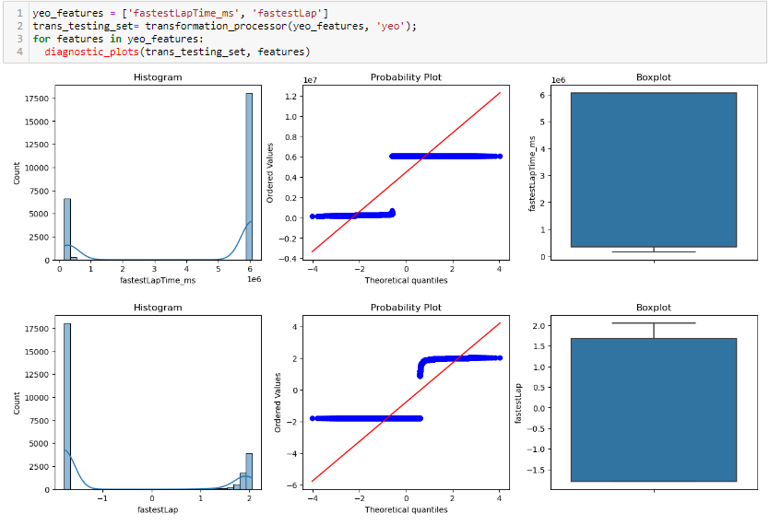
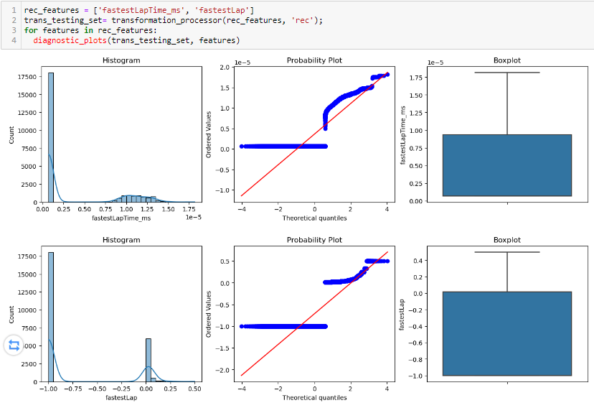
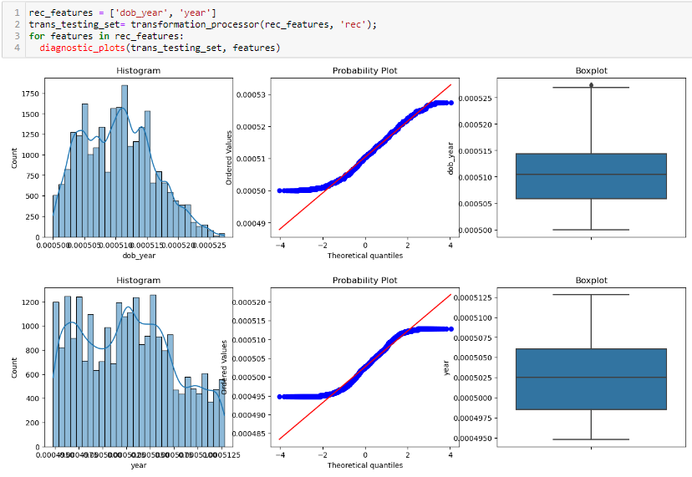
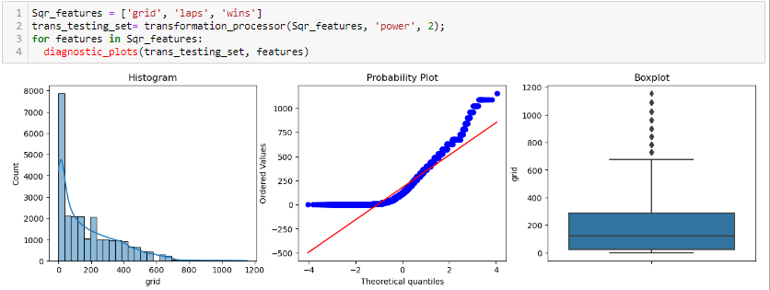
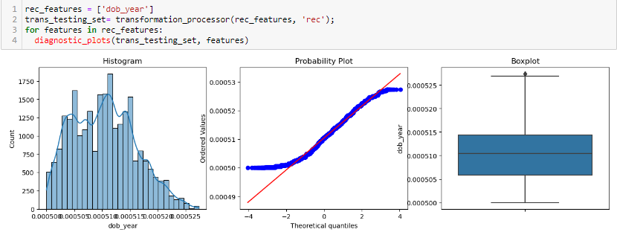
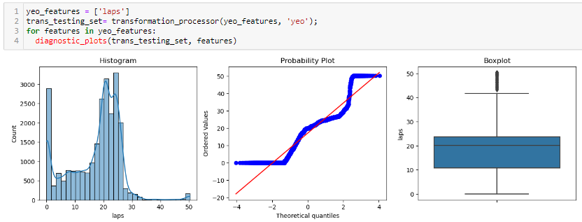
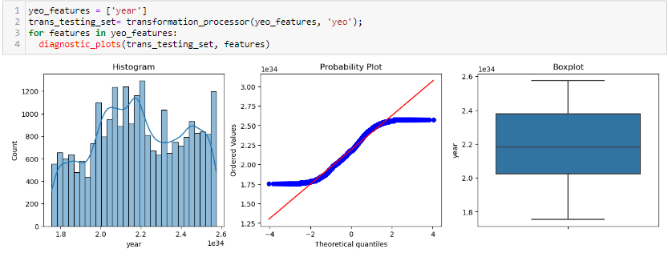
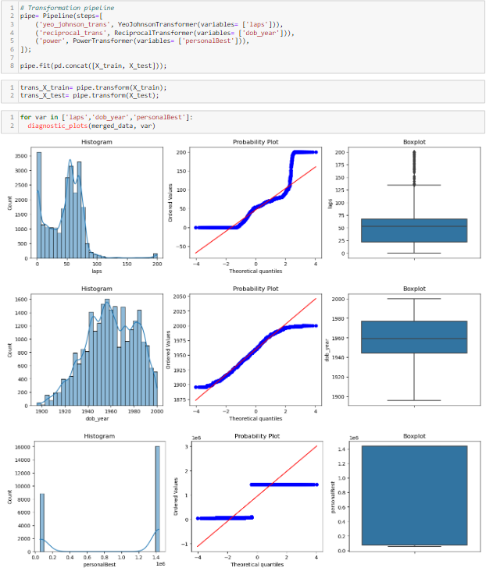
Data Cleansing and Transformation

Slide 24
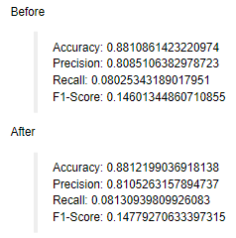
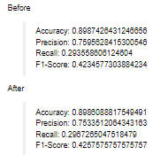
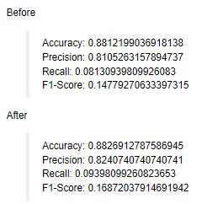
Data Cleansing and Transformation
YJT on ‘laps’
Power T. on ‘personalBest’
Rec T. on ‘dob_year’
Notes:
All other variables
Testing across all transformation methods proved ineffective and made no significant impact to the distribution. Therefore, it is not transformed to preserve its original value which in itself may prove more valuable for analysis.
By applying Yeo Johnson transformation I can suppress the extreme tails and elavate the middle distribution. Therefore, Yeo Johnson transformation was applied to this feature.
dob_year
By applying Reciprocal transformation I can increase skewness and improve distribution. Therefore, Reciprocal transformation was applied to this feature.

Slide 25
Data Cleansing and Transformation
Categorical Transformation

Slide 26
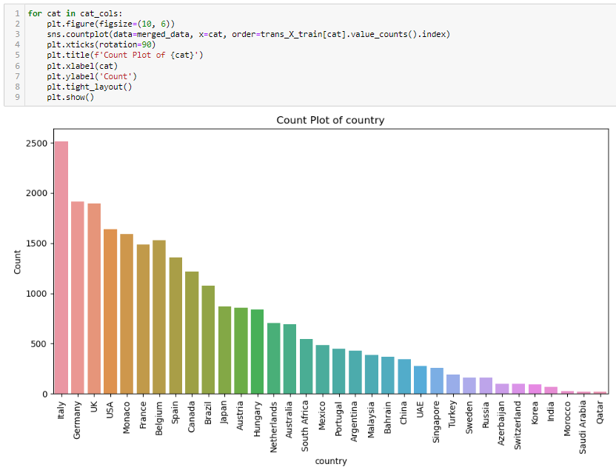
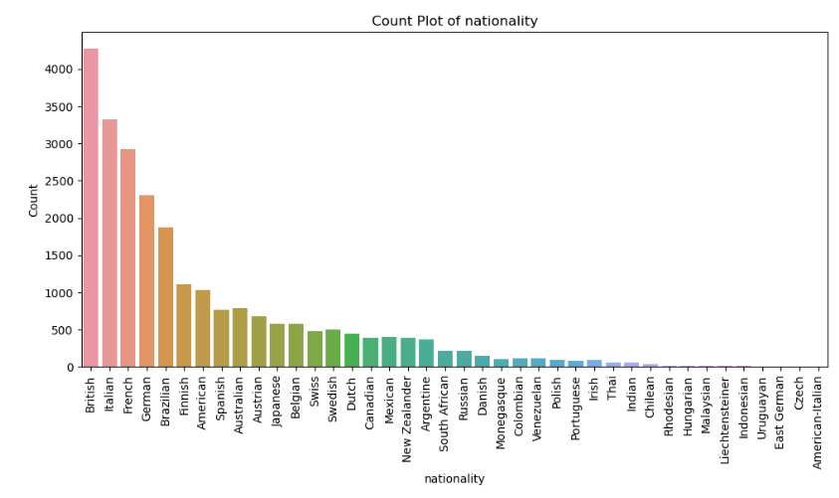
Data Cleansing and Transformation
Notes:
One-Hot Encoding Explanation: Since both variables are nominal categorical variables (Do not have a specific order or hierarchy), one-hot encoding would be the most suitable option

Slide 27
Data Cleansing and Transformation
Variable Discretisation / Binning

Slide 28
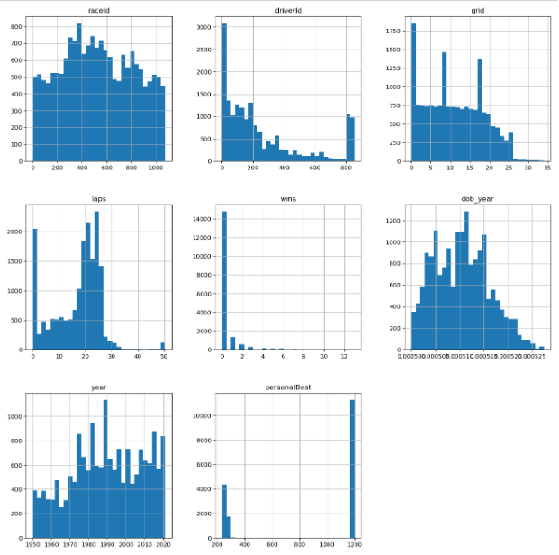
Notes:
raceId and driverId:
These variables are categorical identifiers. Thus, they don't need discretization.
laps, wins:
I decided to use Equal Frequency discretization as the data distribution contains outliers and I want to ensure that each bin represents a similar portion of the data.
personalBest, dob_year and year:
I decided to use Equal Width discretization as I felt that the data can be discretized into time periods.
grid:
I decided to use Equal Width discretization as data is fairly uniform and I want to simplify visualizations or reduce the number of data points for analysis.

Slide 29
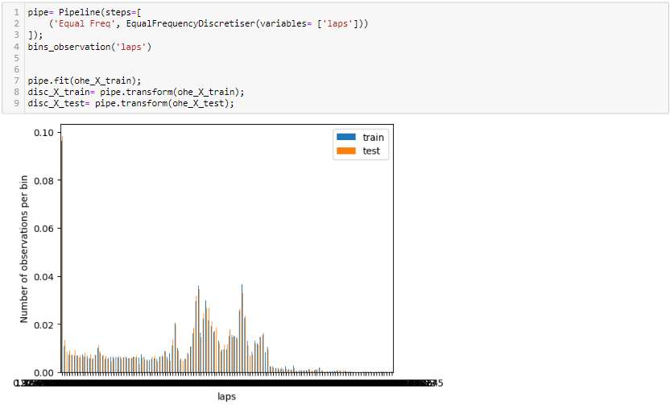
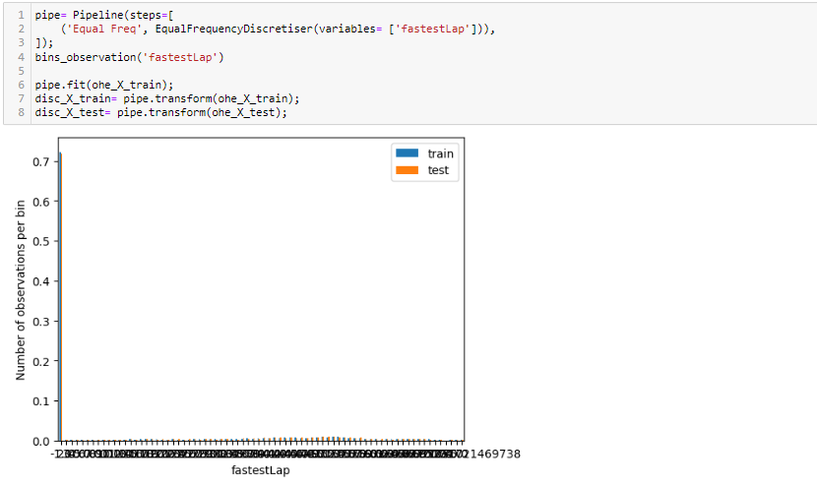
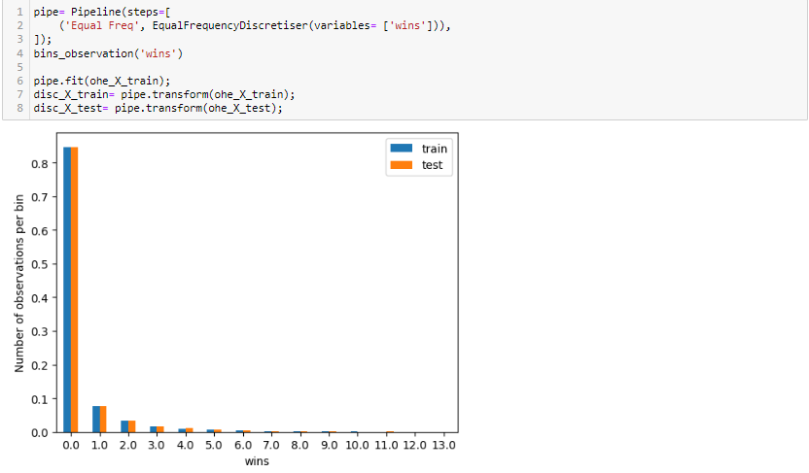
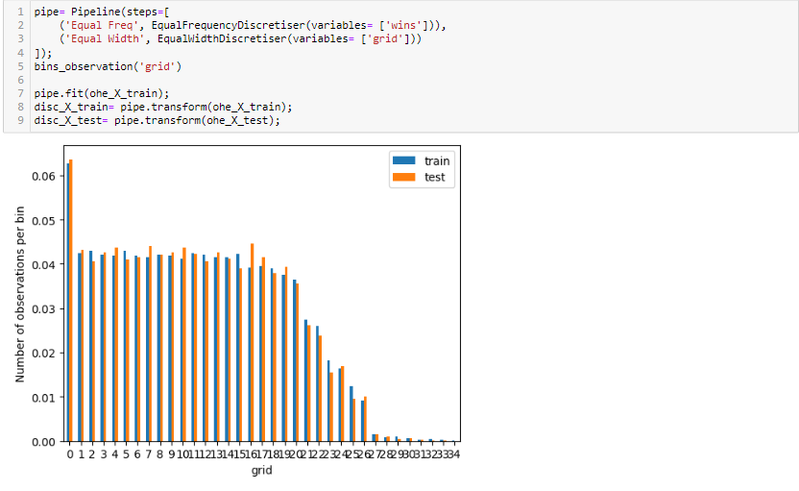
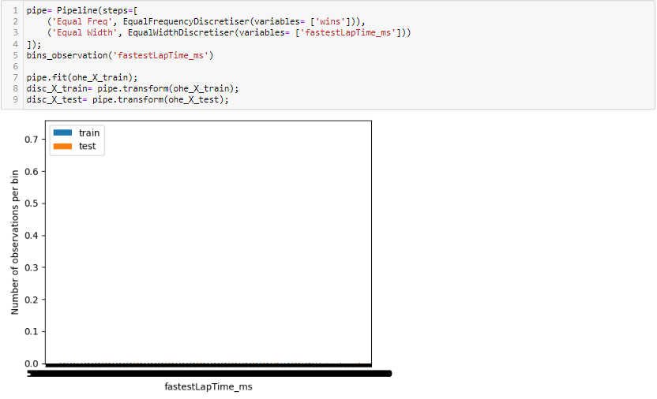
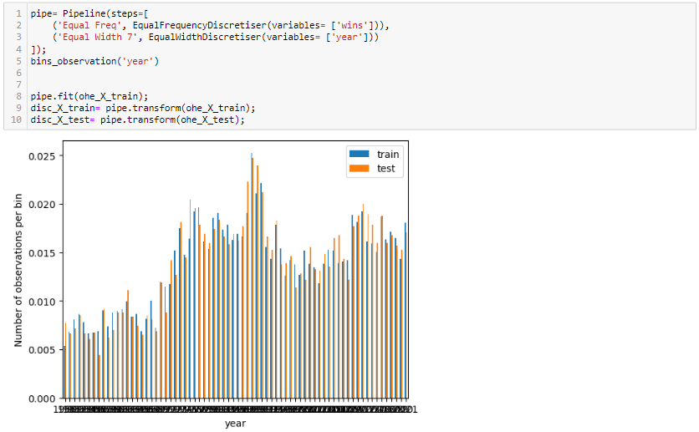
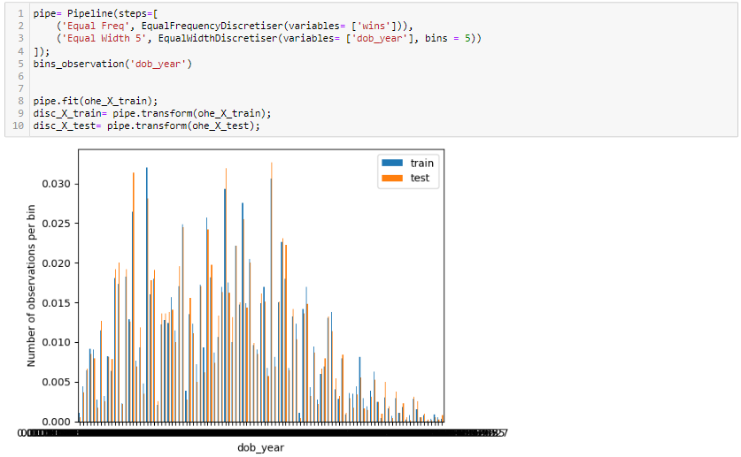
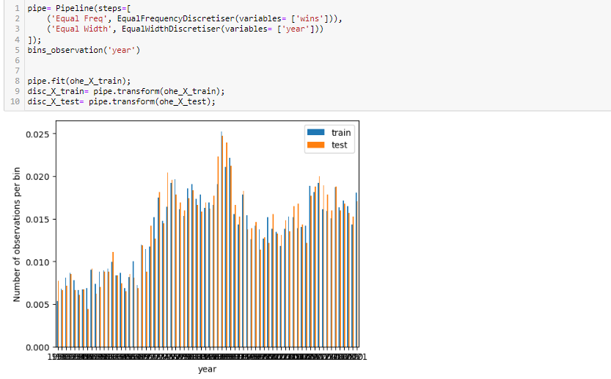
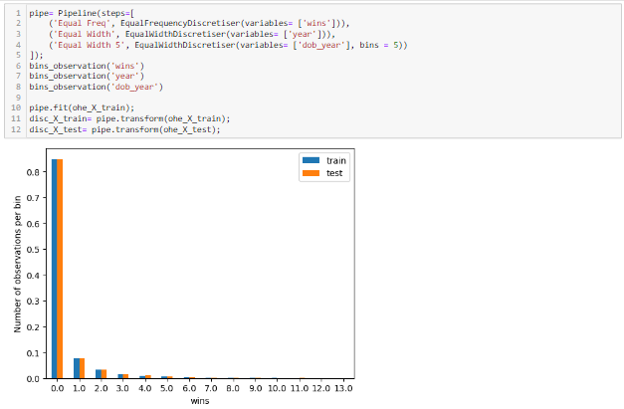
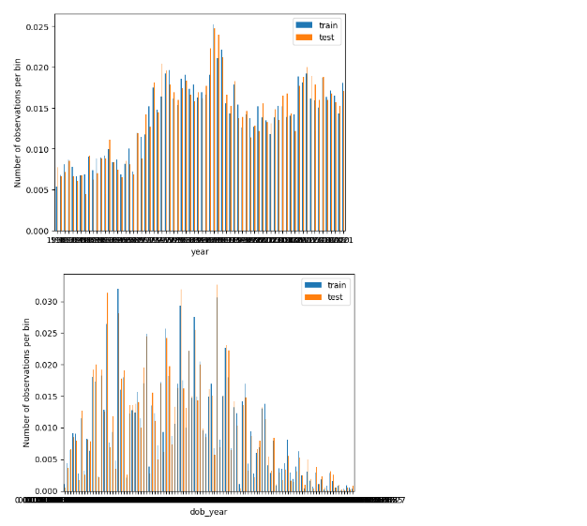
Data Cleansing and Transformation

Slide 30
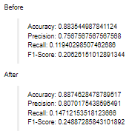
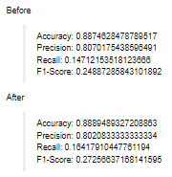
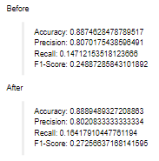
Data Cleansing and Transformation
‘wins’
‘year’
‘dob_year’
Notes:
laps, fastestLap, fastestLapTime_ms, grid:
Testing with various transformation methods proved ineffective and made a negative impact to the distribution. Therefore, it is not transformed to preserve its original value which in itself may prove more valuable for analysis.
wins:
By applying Equal Frequency discretization it can handle outliers as the values are divided into bins such that each bin contains approximately the same number of data points. Therefoe, Equal Frequency discretization is applied to this feature
dob_year and year:
By applying Equal Width discretization the data can be discretized into time periods as the values are divided into bins, each with the same width. Therefoe, Equal Width discretization is applied to this feature

Slide 31
Feature Engineer
Logistic Regression

Slide 32
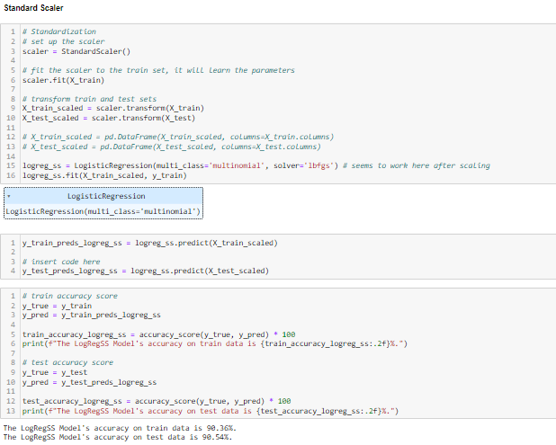
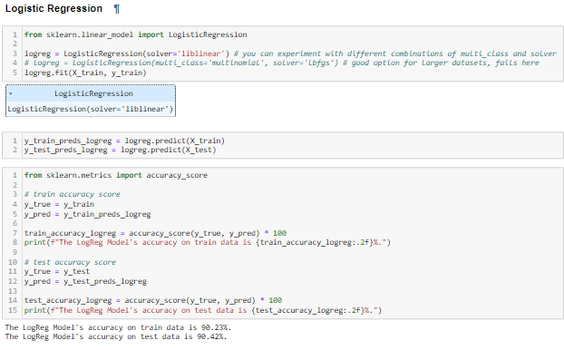
Feature Engineer

Slide 33
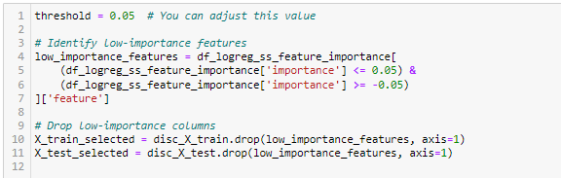
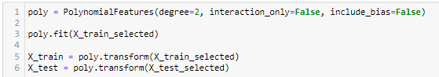
Feature Engineer
Polynomial Expansion
Remove unnecessary columns (columns of low importance) from the model
Before PE:
Accuracy: 0.8888
Precision: 0.7979
Recall: 0.1642
F1-Score: 0.2723
After PE:
Accuracy: 0.8973
Precision: 0.7380
Recall: 0.2942
F1-Score: 0.4207
Notes:
higher recall and F1-Score, which suggests that the model performs better in terms of capturing the actual top 3 drivers (classifying actual positive cases as positive) and achieving a balanced trade-off between precision and recall.

Slide 34
Machine Learning Modelling
Models

Slide 35
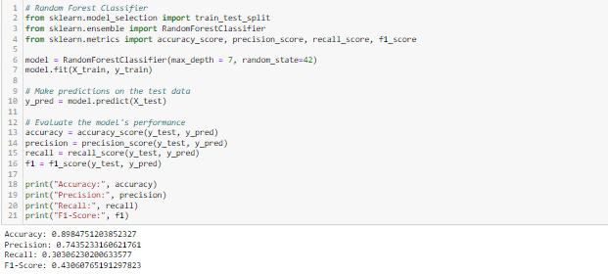

Machine Learning Modelling
Accuracy: 0.8984751203852327
Precision: 0.7435233160621761
Recall: 0.30306230200633577
F1-Score: 0.43060765191297823

Slide 36
Thank You

